Slide 1
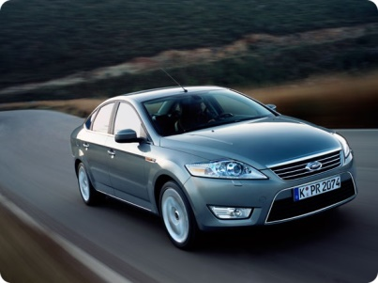
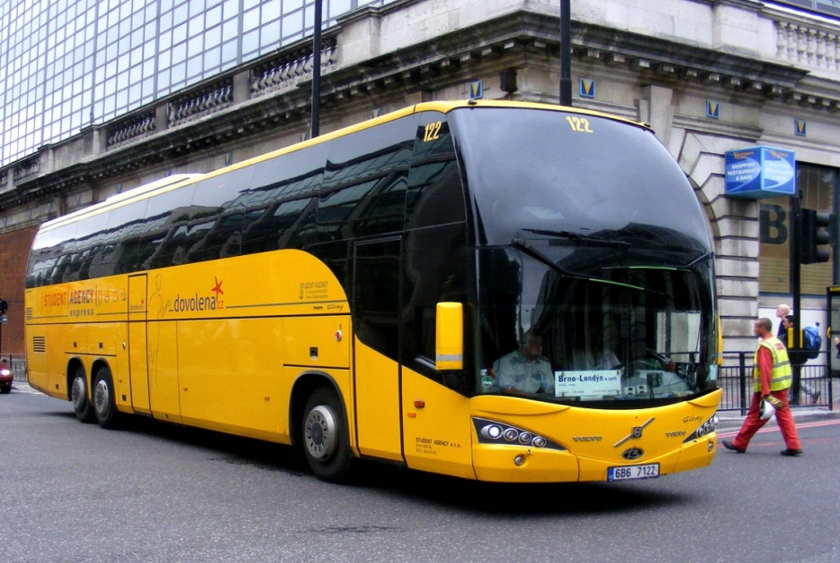
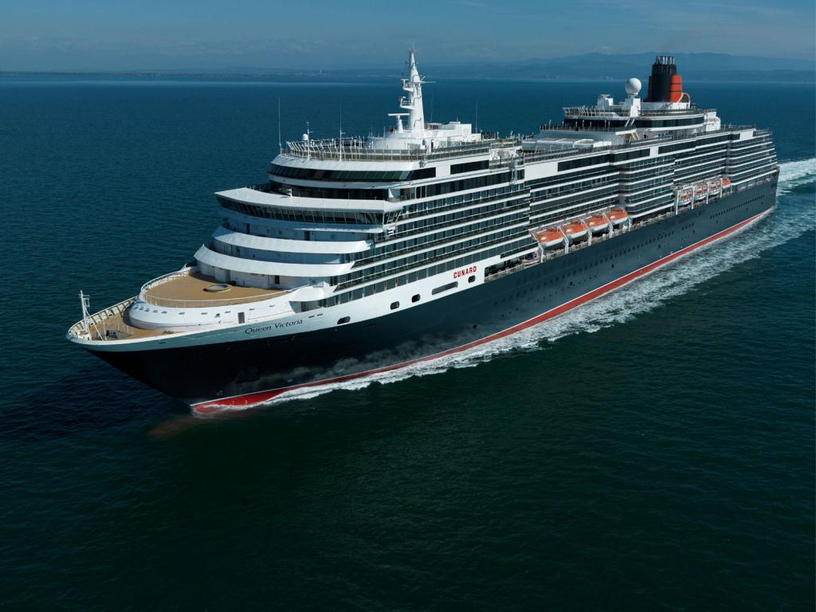
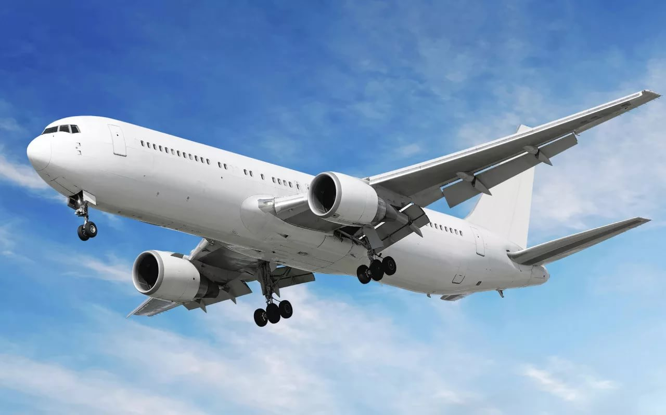

Slide 2
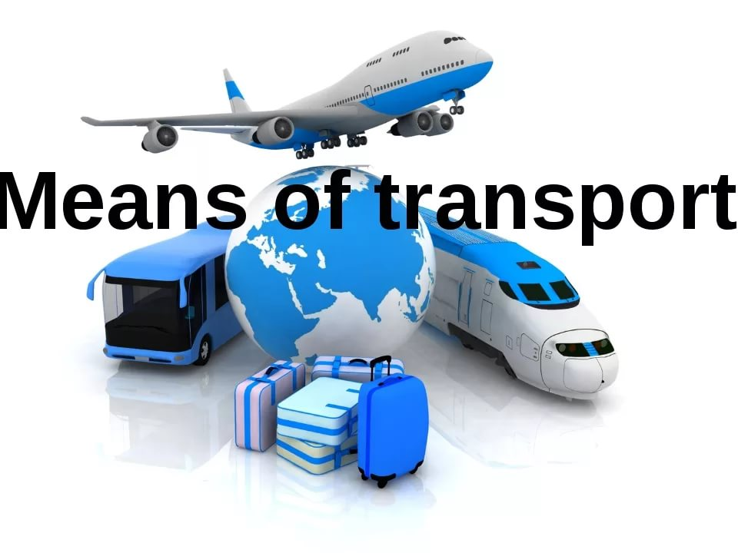

Slide 3
The aim of our lesson is
to learn new words and word combinations on the theme.
to speak about different kinds of transport, tell other people about your favourite means of transport for travelling.

Slide 4
IDIOMS.
Be in the same boat – быть в одной лодке;
Drive someone up the wall – довести кого-либо до белого каления;
Fly someone off – отсылать кого-либо;
Hit the road – уйти с дороги;
Stay of the beaten track – не следовать шаблону;

